Slide 1

40kVA Auxiliary Power Supply
For Mumbai Monorail (MMRDA)
HIND RECTIFIERS LIMITED
1

Slide 2
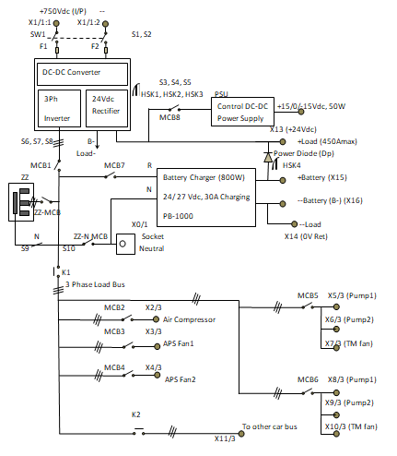
Monorail APS Entire Scheme
The Monorail Auxiliary Power Supply has 750V Nominal DC Input and Two Output viz., a 415V/33A Three Phase AC Output and a 24V/500A DC Output. The proposed topology realizes this requirement by implementing two stages of power conversion. At the input side there are two parallel connected Phase-Shift Full Bridge DC/DC Converters with a Shared leg at the Rectifier Side. This is followed by a Three Phase Inverter to provide the Three Phase AC Output. Additionally, the Three Phase Inverter Output will also have Zig-Zag Transformer to provide a rigid Neutral Point .
HIND RECTIFIERS LIMITED
2

Slide 3
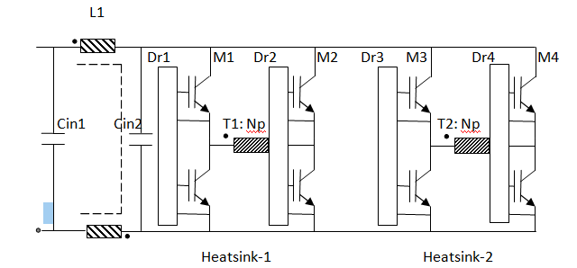
Monorail APS First Stage Two Level Inverter Section
The nominal supply to the APS is 750V DC, however it can fluctuate between 500V dc to 900V dc. The input stage consists of two parallel connected Phase-Shifted Full Bridge Converters. There are two High Frequency Transformers, one for each PSFB Converter. Each of these transformers has one primary winding and two secondary windings, one of the secondary winding produces 700V DC Bus (after rectification) and the other secondary winding produces 24V DC Bus. The 24V DC bus is used as the feedback in its control loop to regulate the output, whereas the 700V DC bus operates in open loop and it is expected to produce the required voltage indirectly through the turns ratio of the transformer.
HIND RECTIFIERS LIMITED
3

Slide 4
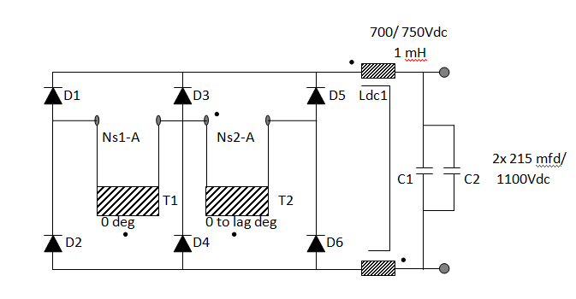
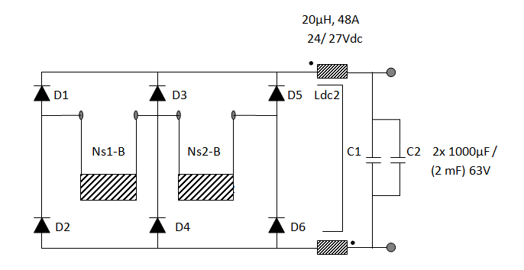
Monorail APS First Stage Rectifier Section
In the Rectifier stage of the DC/DC Converter, one of the leg is shared between the two bridge rectifiers to form this unique topology. It enables the rectified transformer outputs to be connected in series to produce higher output voltage than the supply voltage, as well as to be connected in parallel to produce lower output voltage than the supply voltage. The control is achieved by producing a phase shift between the two PSFB Converters according to the supply voltage. One of the Rectifier output is 700V DC which is further fed into a 3 Phase Inverter, while the other Output is 24V DC.
First Stage Rectifier Side for 700V DC Bus
First Stage Rectifier Side for 24V DC Bus
HIND RECTIFIERS LIMITED
4

Slide 5
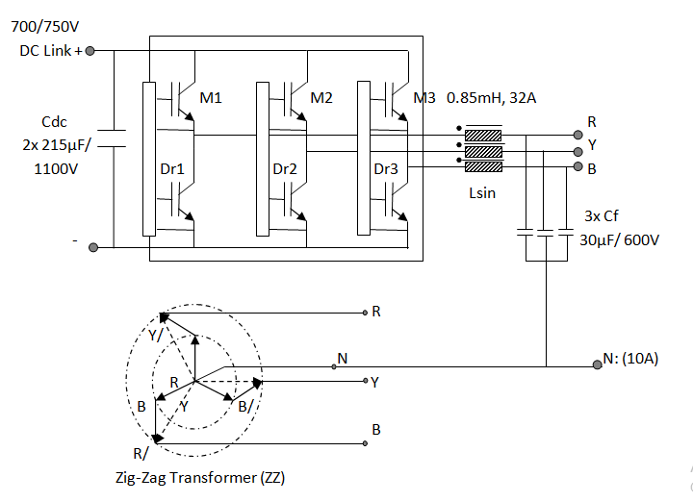
Monorail APS Second Stage Three Phase Inverter
The 700V DC bus is connected to the 3 Phase inverter to produce a 3 Phase AC Output. A Zig-Zag Transformer (Rated for 10A) is also connected to the Output of the 3 Phase inverter to create a rigid neutral point. This will enable to tap a 1 phase output without creating any unbalance at the 3 phase output. Space vector Pulse Width modulation has been implemented in this 3 phase inverter to take care of wider operating range.
3 Phase Inverter with Zig-Zag Transformer
HIND RECTIFIERS LIMITED
5

Slide 6
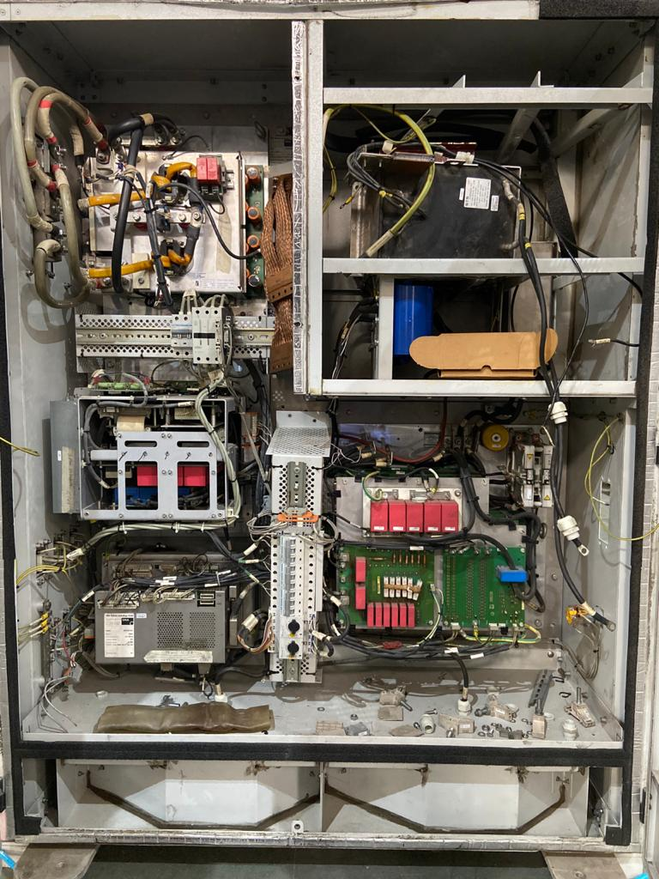
Monorail Old APS
The Older Monorail APS had a range of problems varying from failed Rectifier Diodes, to failed Control Cards, to failed IGBT Modules, (there were even more problems, but these are the major ones). We suspect that the existing topology which seems to implements two Buck Converters (one for each power rail) followed by the Neutral Point Clamped Half Bridge Converter is not robust enough for Indian ambient conditions and also it creates some fundamental problems like unbalance between the input capacitors, successive failure of all the power devices when one of the power devices fails. Etc and hence this topology should have never been implemented.
Inside View of the Old APS
HIND RECTIFIERS LIMITED
6

Slide 7
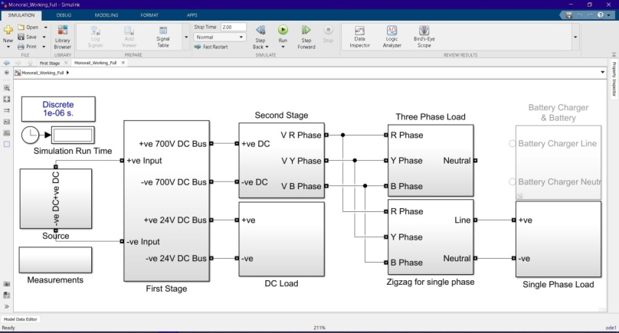
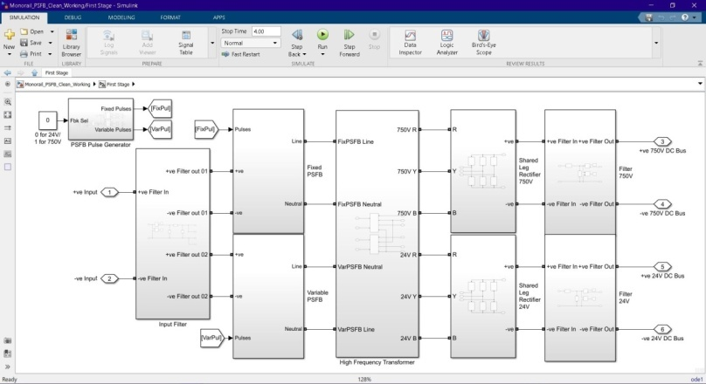
Monorail APS Simulation
The monorail APS has been simulated in MATLAB Simulink R2020a before constructing the test jig and the prototype unit. In simulation, this topology provides higher form factor at the output of the DC/DC Converter, higher efficiency and stable operation as compared to conventional topologies.
Monorail Simulation Entire Block Diagram
Monorail Simulation First Stage Block Diagram
HIND RECTIFIERS LIMITED
7

Slide 8
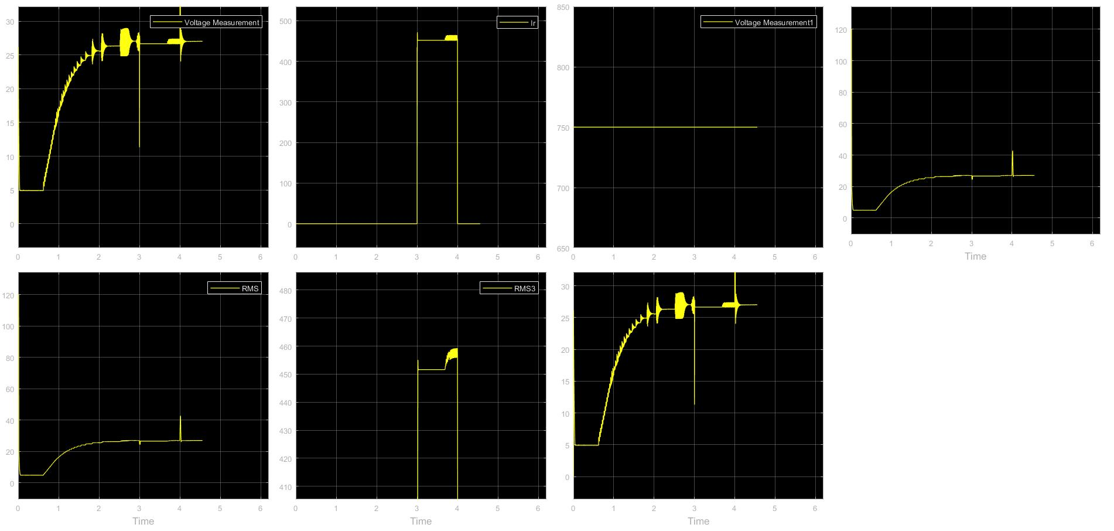
Monorail APS Simulation - 24V Output Waveform
24V Output DC Voltage in the First Window
at Filter Parameters as L = 20uH and C = 2mF.
HIND RECTIFIERS LIMITED
8

Slide 9
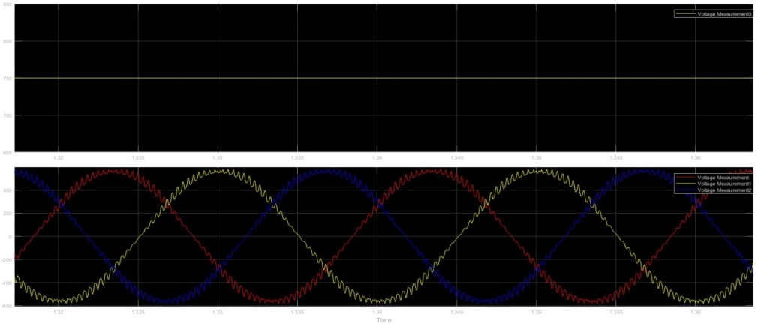
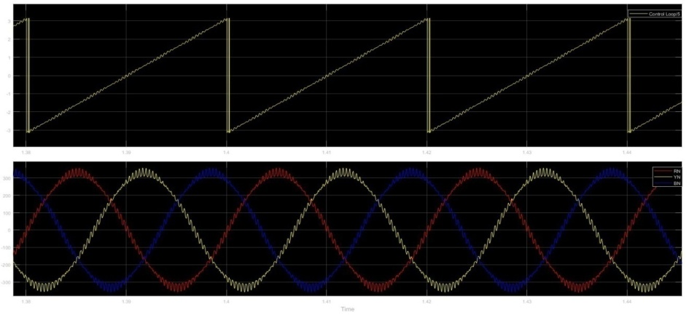
Monorail APS Simulation
3 Phase Line Voltages – Vrms = 415V
First Window is RMS equivalent &
Second Window is Actual Waveform
3 Phase Line Current – Irms = 33A
First Window is Generated Theta equivalent &
Second Window is Actual Waveform
HIND RECTIFIERS LIMITED
9

Slide 10
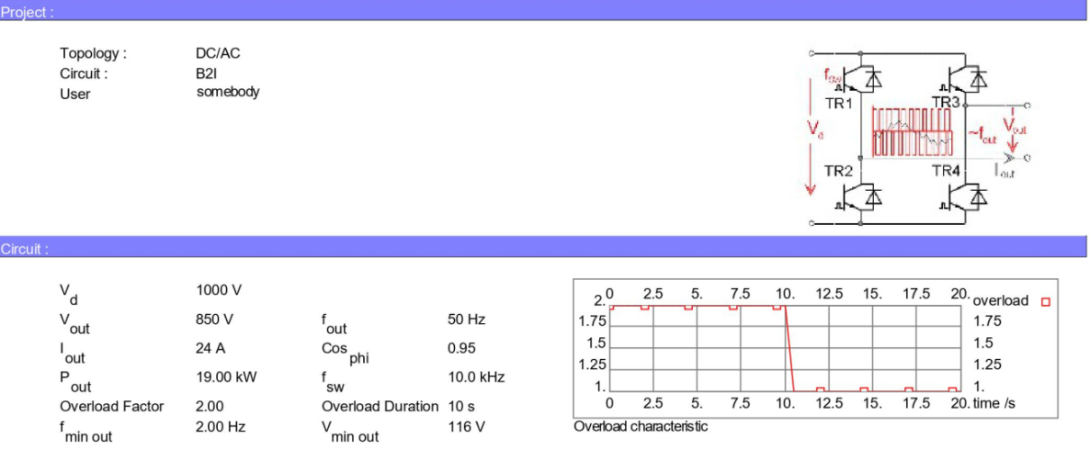
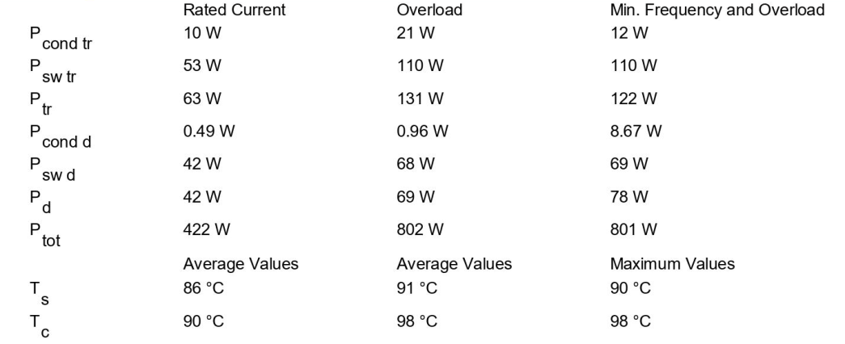
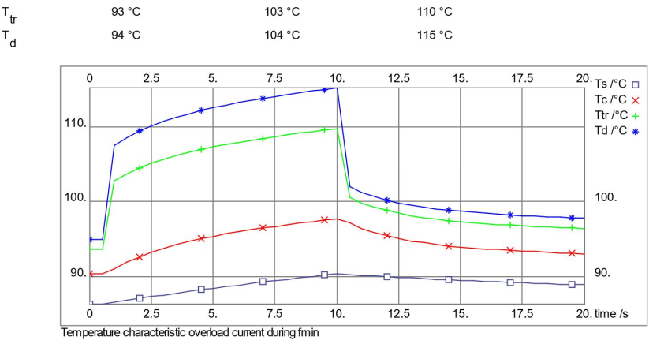
Monorail APS Simulation First Stage Inverter Device Losses
Device Used – Semikron SKM800GA126D
HIND RECTIFIERS LIMITED
10

Slide 11
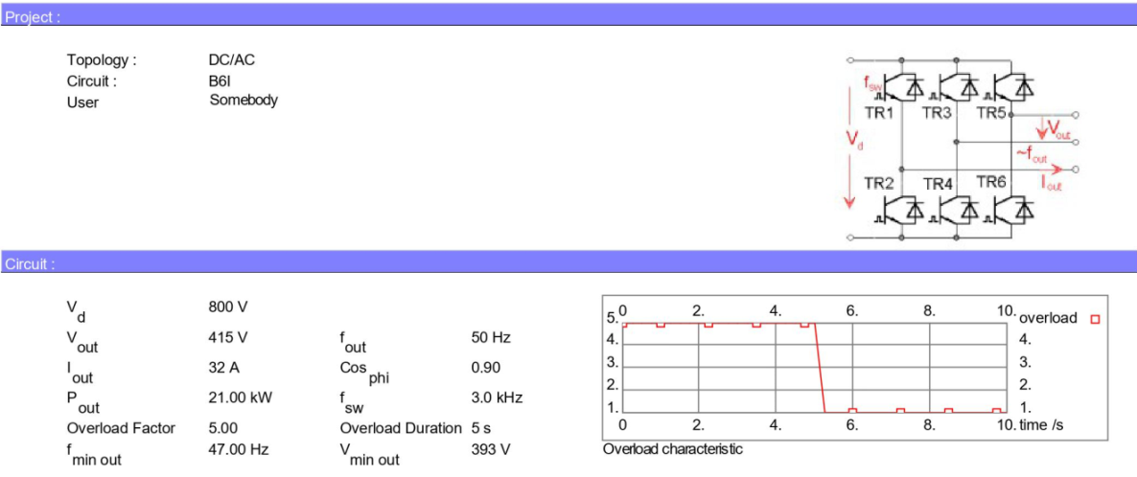
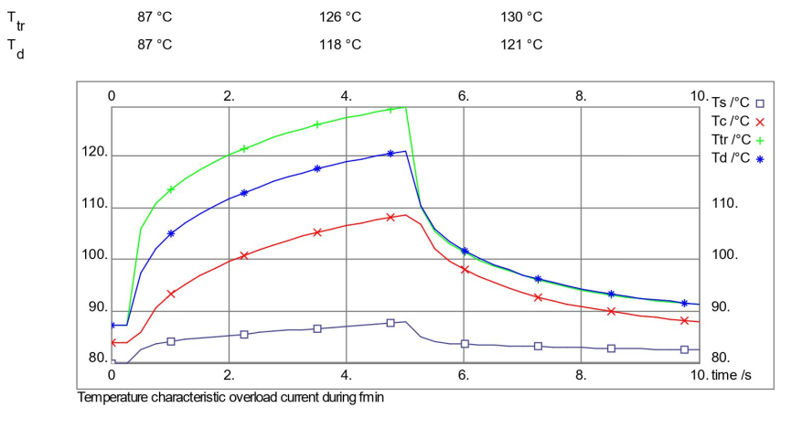
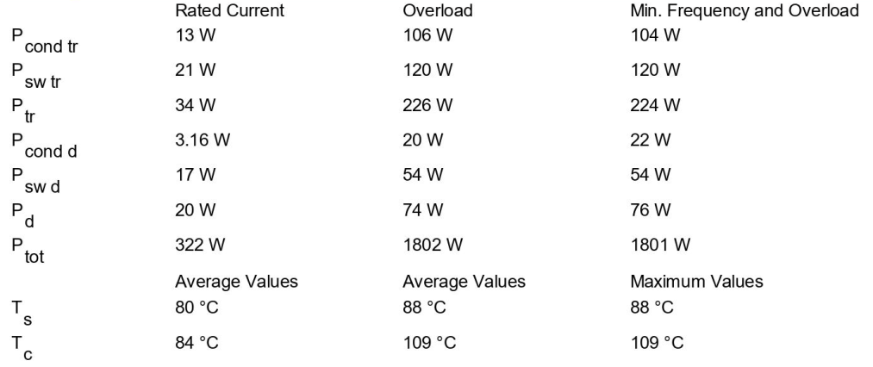
Monorail APS Simulation Second Stage 3 Phase Inverter Device Losses
Device Used – Semikron SKM400GB176D
HIND RECTIFIERS LIMITED
11

Slide 12
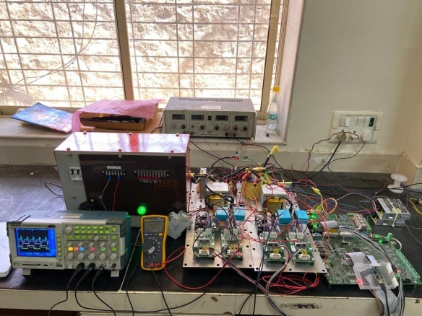
Monorail APS Low Power Test Setup
Monorail APS Low Power Test Setup for the First Stage – Entire Jig
HIND RECTIFIERS LIMITED
12

Slide 13
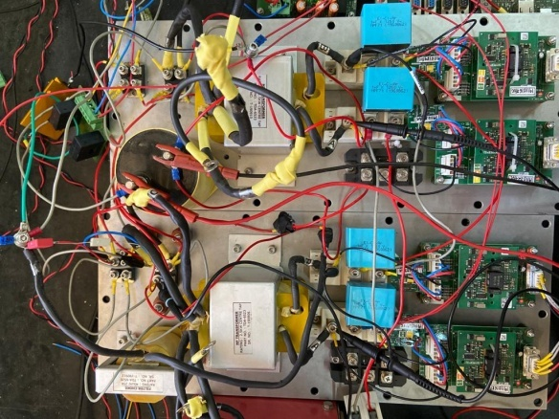
Monorail APS Low Power Test Setup
Components used are:
IGBT Module – Semikron SKM100GB12E4
2.5KW HF Transformer
Diode Module – IXYS DSEI2x101-12A
1uF Snubber Capacitors
40uH Output Choke
100uF Output Film Capacitor
Gate Driver – Semikron Skyper 32
Aluminum Housed 50Ω Resistor for Load
110V/2A DC Power Supply
2Pole C6 MCB
Monorail APS Low Power Test Setup for the First Stage – Power Side
HIND RECTIFIERS LIMITED
13

Slide 14
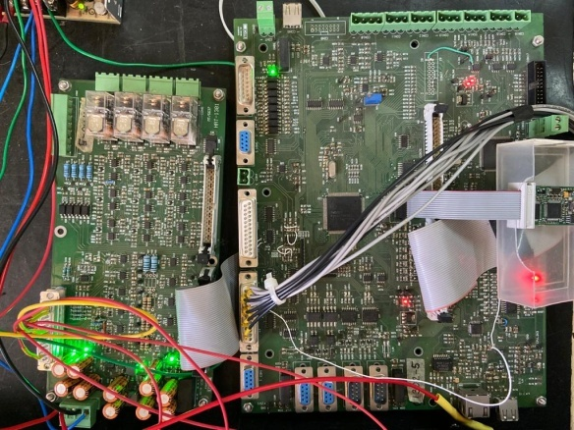
Monorail APS Low Power Test Setup
Components used are:
HRT 1301 Revision 0 Interface Card
HRT 1302 Revision 1 Main Control Card
HR 348 Current Sensor Card
Spectrum Digital XDS100 v3 TMS Debuggger
+/-15V DC SMPS
Monorail APS Low Power Test Setup for the First Stage – Control Side
HIND RECTIFIERS LIMITED
14

Slide 15
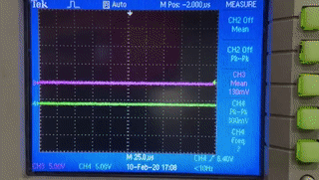
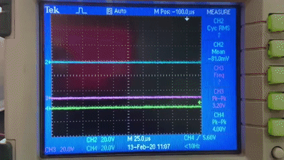
Monorail APS First Stage Inverter Pulses
First Stage Pulses
First Stage Operation
Pulses of the Two Level Inverter Stage of the PSFB Converter. The control is achieved by producing a phase shift between the two PSFB Converters. When the two converters are in phase, at that time the rectifier outputs come in series two produce twice of input voltage (into the turns ratio of the transformer). Conversely, when the two converter are out of phase, the rectifier outputs come in parallel two produce only once of input voltage (into the turns ratio of the transformer). Green Waveform is the Pulse given to the Fixed PSFB, Pink Waveform is the Pulse given to the Phase Varying PSFB while the Blue waveform is the unfiltered rectified DC Output
HIND RECTIFIERS LIMITED
15

Slide 16
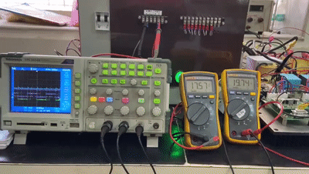
Monorail APS First Stage Operation
First Stage Operation
In this Test setup, the Left Multimeter shows the Input DC Voltage that will be gradually increased from 18V DC to 42V DC (however control exists in the range of 22V to 39V), while the Right Multimeter shows the 24V Regulated Output DC. The transformer used has a turns ratio of 2:1. The output inductor L = 40uH and the output capacitor C = 100 uF. Green Waveform is the Pulse given to the Fixed PSFB, Pink Waveform is the Pulse given to the Phase Varying PSFB while the Blue waveform is the unfiltered rectified DC Output.
HIND RECTIFIERS LIMITED
16

Slide 17
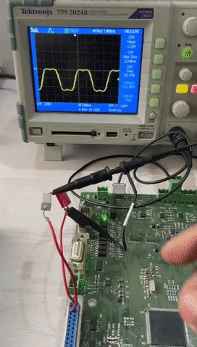
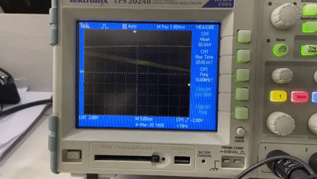
Monorail APS Second Stage Operation
Three Phase Inverter Soft Start
SVM vs. SPWM
In this Test setup, the Sinusoidal Pulses Width Modulation and the Space Vector Modulation based Pulses have been fired from the control card. A star connected R-Network is used to check the pulse. Also, V/f is implemented for Soft-Start.
HIND RECTIFIERS LIMITED
17

Slide 18
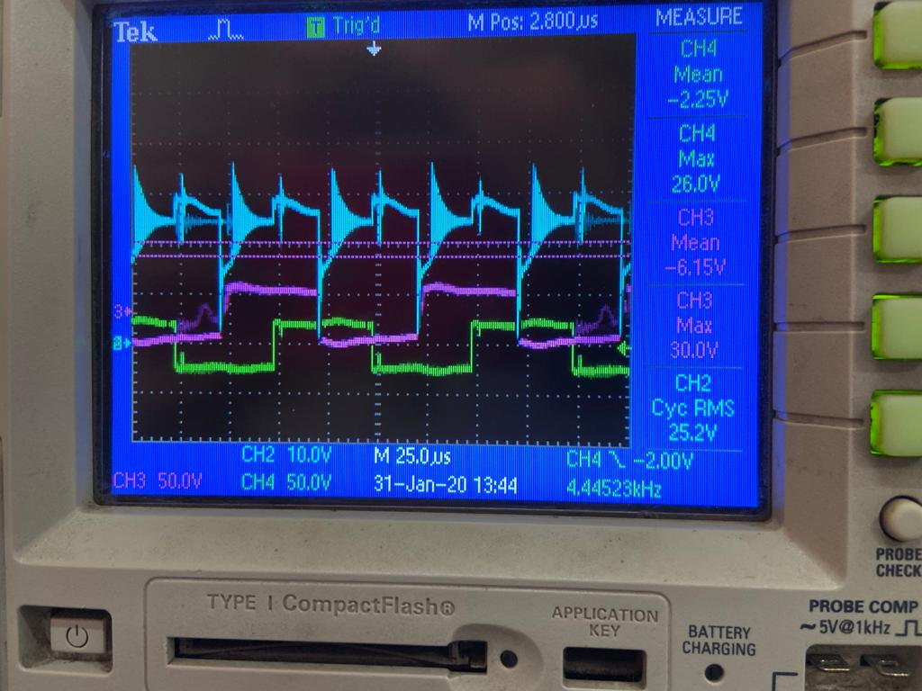
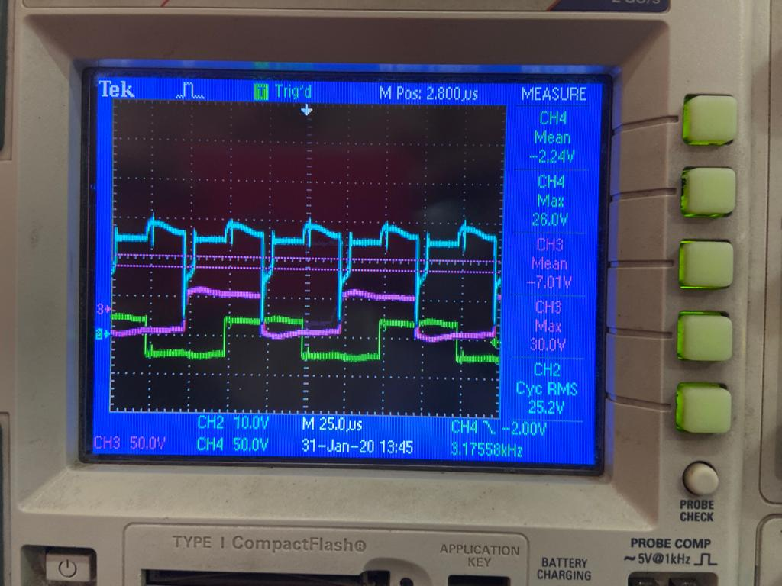
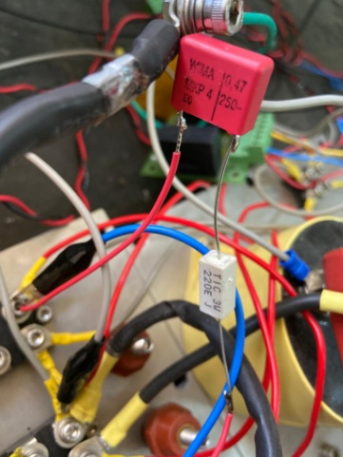
Monorail APS Observed Problems
Ripple on Transformer Primary Before Connecting series RC network
Dampening of Ripple on Transformer Primary After Connecting series RC network
The series RC network that was connected on the Rectifier Output
A high frequency decaying ripple was observed on the transformer primary as well as secondary. It is assumed that an LC Resonant circuit is being formed between the transformer leakage inductance and the IGBT snubber capacitors. This was solved by connecting a small RC network at the Rectifier Output.
HIND RECTIFIERS LIMITED
18

Slide 19
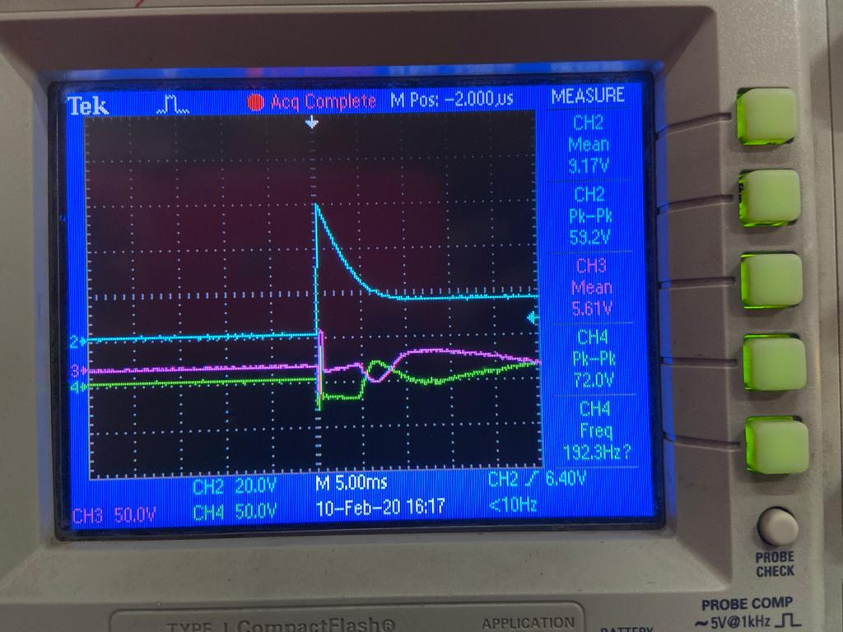
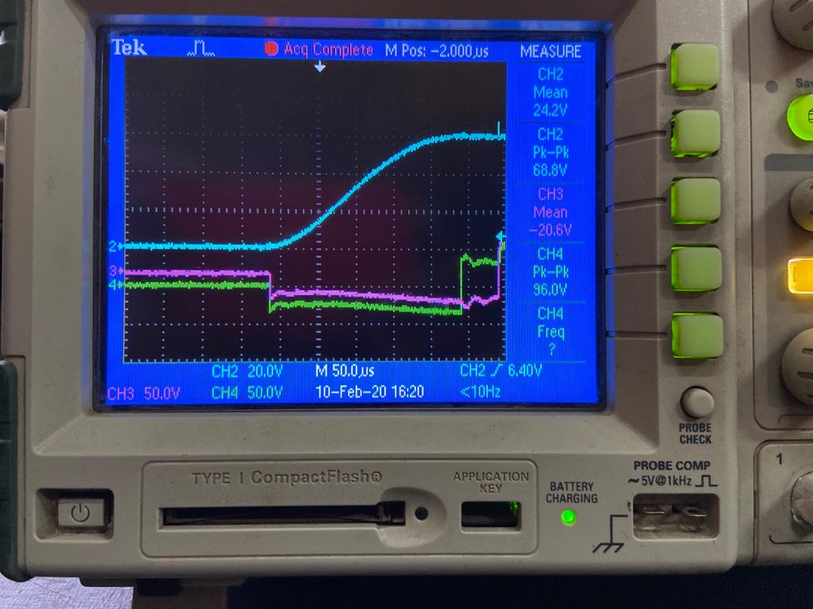
Monorail APS Observed Problems
Output Voltage Spike during Startup – Blue Waveform
Suppression of Output Voltage Spike during Startup – Blue Waveform
The Filtered and Rectified Output DC Voltage shot to very high values during start-up. This was solved by modifying the code by implementing soft start, blanking window for reference and resetting the control parameters initially.
HIND RECTIFIERS LIMITED
19

Slide 20
Monorail APS BOM 01
Sr No. | Part Description | Part Rating | Ckt. Ref. no. | Make | Qty | PART NAME | cost/ unit | cost
1 | Input DC Choke | 0.15/0.5mH | L1 | Hirect | 1 |  | 3000 | 3000
2 | DC Capacitor | 215µF, 1100V | Cin1,Cin2,C1,C2 | Electronicon | 4 | E66.R75-224W20 (Hermetic sealing) | 4177 | 16708
3 | IGBT Driver | To drive 300A/1700V | Dr1,Dr2, Dr3, Dr4 | PI- Arihant | 4 | 2AP0108 (pp PCB) | 4000 | 16000
4 | IGBT Module | 300A/ 1700V | M1,M2,M3,M4 | Semikron INFINEON | 4 | SKM300GB17E4H16 / FF300R17KE4 | 11,000 | 44000
5 | 10 KHz Transformer | 36KVA | T1, T2 | Hirect | 2 |  | 7200 | 14400
6 | UF Diodes Modules FRED | 2x 99A, 1200V, trr = 40n | D1, D2, D3, D4, D5, D6 | IXYS | 6 | DSEI- 2x 101-12A | 1500 | 9000
7 | DC Filter Choke | 1 mH, 32A | Ldc1 | Hirect | 1 |  |  | 0
8 | UF Diodes Modules FRED | 2x 123A, 200V, trr = 50nS | D1, D2, D3, D4, D5, D6 | IXYS | 60 | DSEI-2x 121-02A | 1300 | 78000
9 | DC Filter Choke | 20µH, 48A | Ldc2 | Hirect | 10 |  | 1863 | 18630
10 | DC Link Capacitor | 2200µF, 63Vdc | C1, C2 | Alcon, Electronicon, KEMET | 20 | PEH169MA422VMB2 | 1,425 | 28500
HIND RECTIFIERS LIMITED
20

Slide 21
Monorail APS BOM 02
Sr No. | Part Description | Part Rating | Ckt. Ref. no. | Make | Qty | PART NAME | cost/ unit | cost
11 | IGBT Module | 300A 1700V | M1,M2, M3,M4 | Semikron | 2 | SKM300GB17E4H16 | 13,287 | 26574
11 | IGBT Module | 300A 1700V | M1,M2, M3,M4 | INFINEON (alternative to SKM300...) | 2 | FF300R17KE4 | 11,348 | 22696
12 | IGBT Driver | To drive 300A/1700V | Dr1,Dr2,Dr3 | PI- Arihant | 3 | 2AP0108 (pp PCB) | 5155 | 15465
13 | AC Filter Choke | 0.85mH, 32A | Lsin | Hirect | 1 | 3 phase | 9115 | 9115
14 | AC Filter Capacitor | 30µF 600Vdc | Cf | Ducati Electronicon | 3 | Star Connected | 1172 | 3516
15 | DC Link Capacitor | 215µF, 1100Vdc | C1, C2 | Alcon, Electronicon | 2 | E66.R75-224W20 (Hermetic sealing) | 4177 | 8354
16 | ZigZag Transformer | 10An | ZZ | Hirect | 1 |  | 12255 | 12255
17 | Battery Charger | 24Vdc 1000W | BC | Meanwell | 1 | PB-1000 | 20,000 | 20000
18 | Controller PCB |  | PCB1 | Hirect | 1 | HRT 1302 |  | 0
19 | Interface PCB |  | PCB2 | Hirect | 1 | HRT 1301 |  | 0
20 | Panel |  |  | Hirect | 1 | Similar to Scomi-SMA |  | 0
HIND RECTIFIERS LIMITED
21

Slide 22
Monorail APS BOM 03
Sr No. | Part Description | Part Rating | Ckt. Ref. no. | Make | Qty | PART NAME | cost/ unit | cost
21 | Input 750Vdc, 2w-Connector | 200A | X1:1 & X1:2 | Harting | 1 | GP 2 pole |  | 0
22 | Input HRC Fuse & Fuse Holder | 125A, 1000Vdc | F1, F2: pair | Siemens | 1 | 2 pole | 19633 | 19633
23 | Non-Fused Isolator: 2pole | 160A | SW1 | Schaltbau | 1 | DC Contactor, 24Vdc Coil |  | 0
24 | Inverter output MCB | 50A | MCB1 | Schneider | 1 | 3 pole, 440V | 6900 | 6900
25 | Z Trafo input | 10A | ZZ-MCB | Schneider | 1 | 3 pole, 440V | 4381 | 4381
26 | Z Trafo N | 20A | ZZ-N MCB | Schneider | 1 | 1 pole, 250V | 1020 | 1020
27 | Bus Control | 63A | K1, K2 | Schneider | 2 | 3 pole Contactor | 12912 | 25824
28 | Air Compress | 20A | MCB2 | Schneider | 1 | 3 pole, 440V | 4233 | 4233
29 | APS Fan 1, 2 | 1A | MCB3, MCB4 | Schneider | 2 | 3 pole, 440V | 4448 | 8896
30 | Cooling Pump | 6A | MCB5, MCB6 | Schneider | 2 | 3 pole, 440V | 4520 | 9040
HIND RECTIFIERS LIMITED
22

Slide 23
Monorail APS BOM 04
Sr No. | Part Description | Part Rating | Ckt. Ref. no. | Make | Qty | PART NAME | cost/ unit | cost
31 | BC input | 10A | MCB7 | Schneider | 1 | 1 pole, 250V | 4381 | 4381
32 | Blocking Diode | 500Adc | Dp: 3parallel | Vishay | 3 | VS-203CNQ100PBF | 3,500 | 10500
33 | Control DC-DC Input | 5A | MCB8 | Schneider | 1 | 1 pole, 250V | 1020 | 1020
34 | Control Power Supply | +24V// +15V | PSU | Meanwell | 2 | 30W DC-DC DDR-30G-15 | 1,500 | 3000
35 | Control Power Supply | +24V// -15V | PSU | Meanwell | 1 | 15W DC-DC DDR15-G-15 | 1,200 | 1200
36 | Heat sink assy | 804W | HSK1 |  | 1 | P16_300_16B |  | 0
37 | Heat sink assy | 804W | HSK2 |  | 1 | P16_300_16B |  | 0
38 | Heat sink assy | 804W | HSK3 |  | 1 | P16_300_16B |  | 0
39 | Heat sink assy | 804W | HSK4 |  | 1 | P16_300_16B |  | 0
40 | Cooling Fan | 350W | APS_Fan1 | Rosenberg | 1 | DKH_280-2_W.087.5FA | 37500 | 37500
HIND RECTIFIERS LIMITED
23

Slide 24
Monorail APS BOM 05
Sr No. | Part Description | Part Rating | Ckt. Ref. no. | Make | Qty | PART NAME | cost/ unit | cost
41 | Input Power Connector | 200A male | X1 | Harting | 2 | HAN200 09140012663 | 3725 | 7450
42 | Housing for 2x HAN200 |  | X1 | Harting | 1 | HAN HPR 09400160311 | 3000 | 3000
43 | Mounting Frame HAN200 |  | X1 | Harting | 1 | 9140240303 | 1300 | 1300
44 | Female Blank-Dummy for HAN200 |  | X1 | Harting | 2 | 9140009950 | 200 | 400
45 | Input DC voltage Sense | 2000Vdc:50mA | S1 | LEM/ Electrohms | 1 | Hall or Linear Opto LV100-2000 / VJ1K5T03 | 9414 | 9414
46 | Input DC Current Sense | +/-100A: 50mA | S2 | Electrohms | 1 | Hall Current Sense HE100T04 | 1100 | 1100
47 | 750Vdc Inv DC Link Volt | 2000Vdc: 50mA | S3 | LEM/ Electrohms | 1 | Hall or Linear Opto VJ1K5T03 | 9414 | 9414
48 | 24Vdc Sense | 150V: 25mA | S4 | LEM/ Electrohms | 1 | LRM_LV25P_Hall or Linear Opto VHASM150T01 | 4600 | 4600
49 | 500Adc Load on 24V sense | 500A: 50mA | S5 | LEM/ Electrohms | 1 | Hall Current Sense CAB500 HS400T01 (OL) | 11239 | 11239
50 | Inverter Output Vac | 400V: 25mA | S6, S7, S8 | LEM/Electrohms | 3 | R,Y,B wrt Nzz LV25P/VHASM400T01 | 4600 | 13800
51 | Zigzag Neutral Current | 20A: 1.00A | S9 | AE/ Meco/CG | 1 | 50Hz CT | 750 | 750
52 | Inverter Output Load | 50A: 50mA | S10 | LEM/ Electrohms | 3 | Hall Current Sense HE050T04 (CL) | 1100 | 3300
53 | IGBT Module | 300A 1700V | M1,M2, M3,M4 | Semikron | 2 | SKM300GB17E4H16 | 13,287 | 26574
53 | IGBT Module | 300A 1700V | M1,M2, M3,M4 | INFINEON (alternative to SKM300...) | 2 | FF300R17KE4 | 11,348 | 22696
54 | IGBT Driver | To drive 300A/ 1700V | Dr1,Dr2, Dr3,Dr4 | PI- Arihant | 2 | 2AP0108 (pp PCB) | 5155 | 10310
55 | Input DC voltage Sense | 2000Vdc: 50mA | S1 | LEM/ Electrohms | 1 | Hall or Linear Opto LV100-2000 / VJ1K5T03 | 9414 | 9414
HIND RECTIFIERS LIMITED
24

Slide 25
Monorail APS Completed Work
Completed Work:
1. Tested the software of 3Phase Inverter with the following control methods:
Sinusoidal PWM & Space Vector PWM (SVM is preferred due wide range and fluctuations of DC Bus).
2. Tested the closed loop logic of the 3 Phase Inverter by creating virtual feedbacks in the code itself.
(The 3 Phase Inverter’s hardware has not been tested yet).
(Current Loop for this 3 Phase Inverter has not been implemented yet).
Voltage Control Loop.
3. Tested the software of the First Stage on test jig (V-out = 24Vdc, I-out = 2A load) with the these conditions:
Voltage Control Loop & Current Control Loop.
4. Initialized ADC for the following parameters:
ADC A0 - V R-phase, ADC A1 - V Y-phase, ADC A2 - V B-phase.
ADC B0 - V dc link, ADC D1 - V input, ADC D2 - I dc link.
5. Tested the Hierarchical Tripping logic (both Non-Latch Fault & Latch Fault) of the First Stage:
Output Over-current, Output Overvoltage, Input Overvoltage.
6. Implemented Soft Start for First Stage (Phase Shifted Full Bridge Rectifier).
7. Implemented V/f (Soft Start) for Second Stage (3 Phase Inverter).
8. Simulated the entire system on Simulink at following conditions
No Load, 50% Load, Full Load, 50% Overload & 25% Input Voltage Spike.
9. Modified code to suppress input voltage spikes observed at the input of the first stage.
10. Modified hardware to dampen resonance observed across the rectifier output of the first stage.
HIND RECTIFIERS LIMITED
25

Slide 26
Monorail APS Completed Work
Things to be done next:
1. Simulating the 800W Battery Charger and its effects on the 3 Phase Inverter Output.
2. Implementing Current Loop in the 3 Phase Inverter.
3. Implementing VMS and CAN Bus communications as required.
4. Further trips have to be implemented like Over-temperature, DC Bus Overvoltage, Input Under-voltage, Earth Fault, Output Short-circuit, etc.
5. Implement Hardware components for pre-charging of the input capacitors (Input Current shoots dangerously high during start-up leading to fall of DC Bus, Stability issues in Transient period and other problems as seen in Simulink simulation).
6. Implement Bleeder resistor to dissipate voltage in No-load connection (DC Bus Voltage stays dangerously high at 800V to 1.4KV if the load gets disconnected as seen in Simulink simulation).
7. Modifying the software to make it compatible with Flash ROM rather than RAM.
HIND RECTIFIERS LIMITED
26

Slide 27
Thank You!
HIND RECTIFIERS LIMITED
27

